Slide 1
Creation of a rapid, reliable, and user-friendly transpiler

Slide 2

Motivations

Slide 3
Aims of the project
Rapid
Reliable
User friendly

Slide 4
Background and key terms
Background and key terms
Transpiler
  A program that translates code from one programming language to another
Lexer
  The stage where the file is split into tokens
Tokens
  Units of meaning in a language
Parser
  The stage where the tokens are arranged in an abstract syntax tree to represent their collective meaning
Transpiler
  A program that translates code from one programming language to another
Lexer
  The stage where the file is split into tokens
Tokens
  Units of meaning in a language
Parser
  The stage where the tokens are arranged in an abstract syntax tree to represent their collective meaning
Abstract Syntax Tree
  A tree structure representing how the tokens will interact when the program is run
Code generation
  The stage where the output code is generated
Identifiers
  A name which can be assigned to hold a value
Pseudocode
  Simple and high level code which is easy to read and understand
Abstract Syntax Tree
  A tree structure representing how the tokens will interact when the program is run
Code generation
  The stage where the output code is generated
Identifiers
  A name which can be assigned to hold a value
Pseudocode
  Simple and high level code which is easy to read and understand

Slide 5
Key stages of the project
Research
Coding
Testing
Debugging
Improving

Slide 6
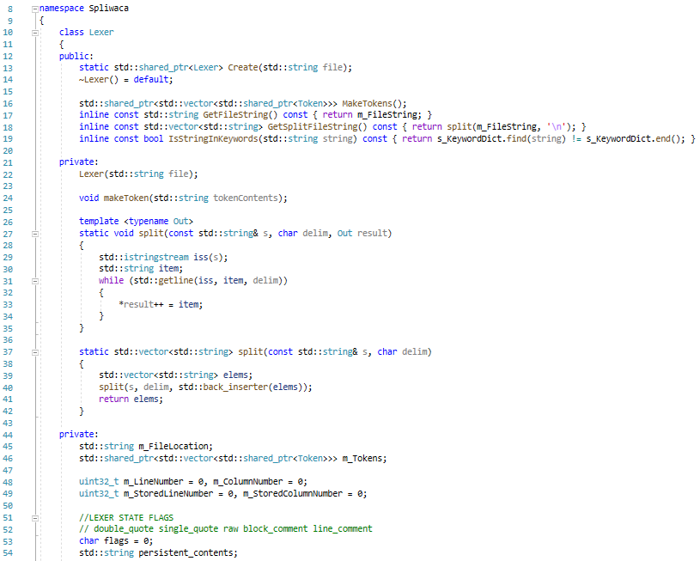
Lexer

Slide 7
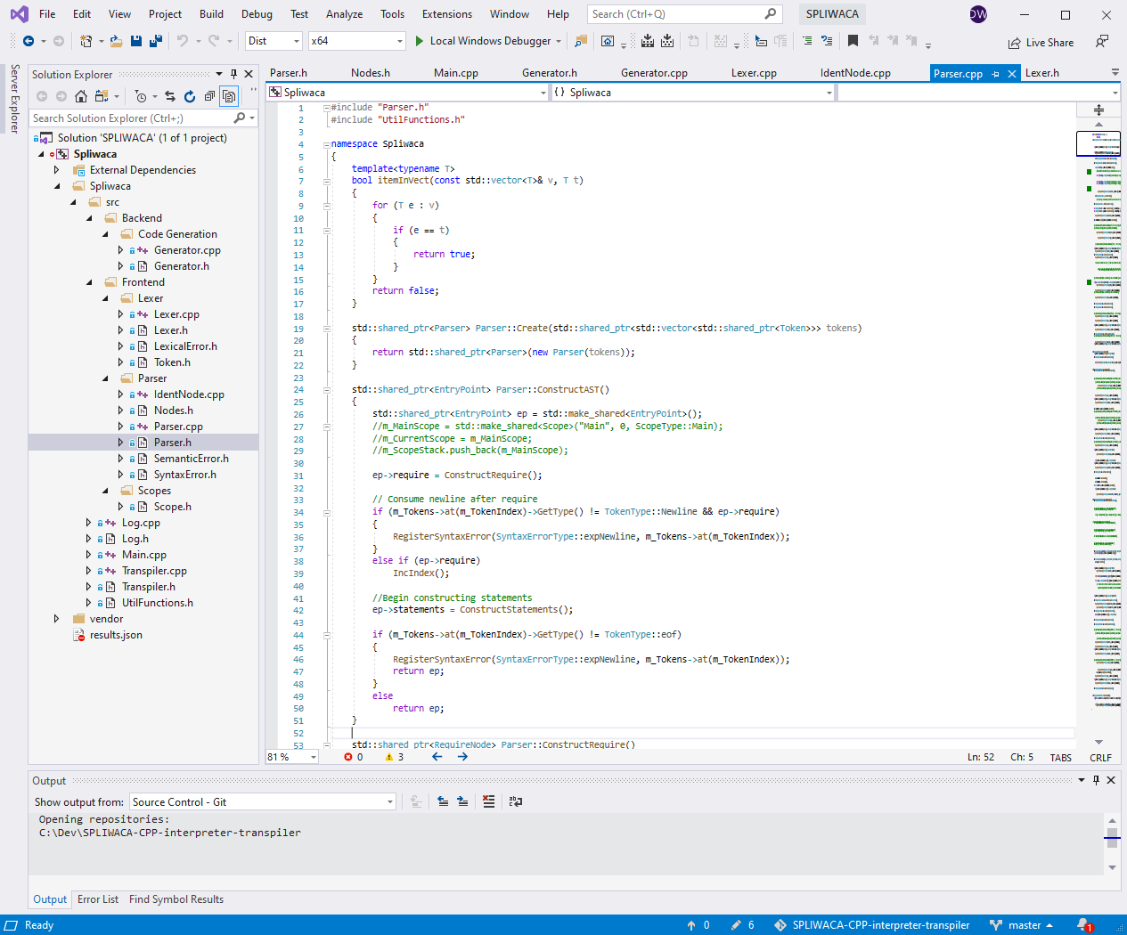
Parser

Slide 8
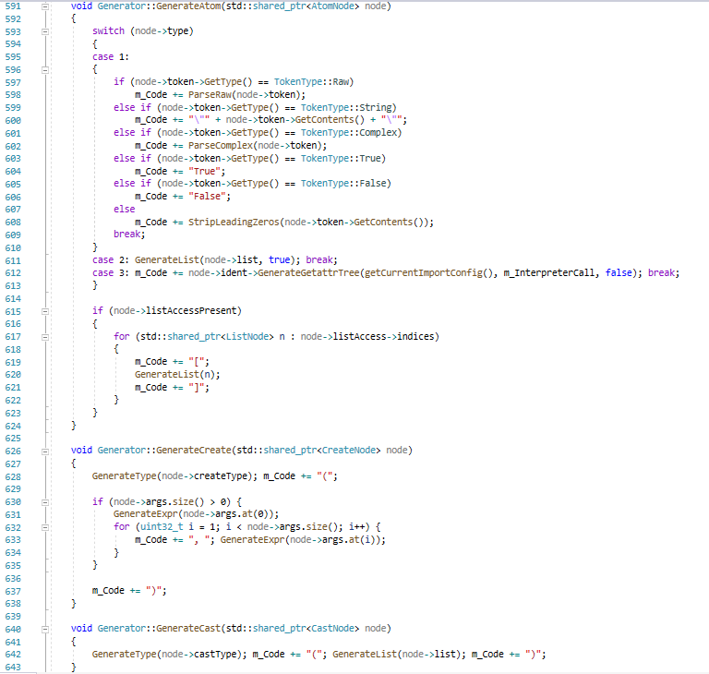
Generator

Slide 9
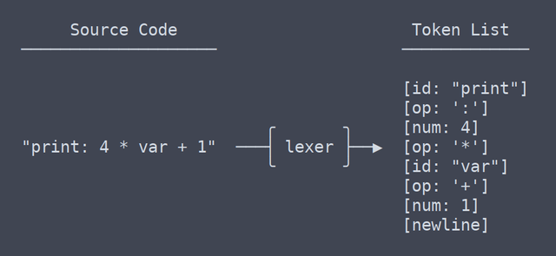
Lexer rewrites
Twice
First time because it did not work
Second time for efficiency

Slide 10
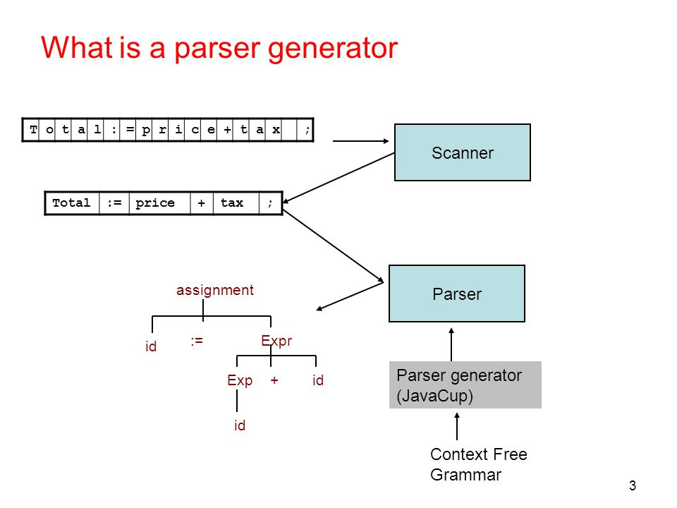
Parser initial structure

Slide 11
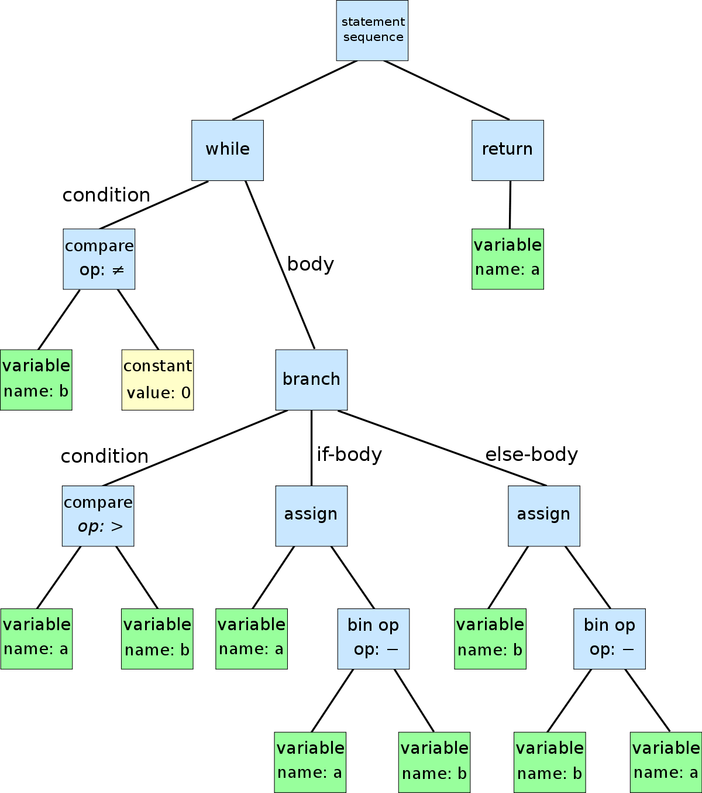
Parser evolution

Slide 12
Semantic analysis and runtime tools
Type checking
Does my variable exist or am I making a mistake?
LibSPLW on PyPI

Slide 13
SPLIWACA transpiler input:
REQUIRE transpiler_py
NOINSTALL
FUNCTION fahrenheit_to_celsius <- FLOAT fahrenheit -> FLOAT AS
NOIMPORT
RETURN (fahrenheit - 32) * 5 / 9
END FUNCTION
FUNCTION celsius_to_fahrenheit <- FLOAT celsius -> FLOAT AS
RETURN (celsius * 9 / 5) + 32
END FUNCTION
FUNCTION tempConvert <- FLOAT temperature, STRING CorF -> FLOAT AS

Slide 14
Python output
import libsplw
scope_vars = libsplw.default_scope.copy()
@libsplw.type_check()
def __func_name_line_3_char_9(prev_scope_vars: dict, arg0: float) -> float: # Source line 4
scope_vars = prev_scope_vars.copy()
scope_vars['fahrenheit'] = arg0
return (libsplw.get_safe(scope_vars, 'fahrenheit', False, False, False, True) - 32) * 5 / 9 # Source line 6
raise libsplw.FunctionEndError
scope_vars['fahrenheit_to_celsius'] = __func_name_line_3_char_9
@libsplw.type_check()
def __func_name_line_8_char_9(prev_scope_vars: dict, arg0: float) -> float: # Source line 9
scope_vars = prev_scope_vars.copy()
scope_vars['celsius'] = arg0
return (libsplw.get_safe(scope_vars, 'celsius', True, True, False, True) * 9 / 5) + 32 # Source line 10
raise libsplw.FunctionEndError
scope_vars['celsius_to_fahrenheit'] = __func_name_line_8_char_9
@libsplw.type_check()
def __func_name_line_12_char_9(prev_scope_vars: dict, arg0: float, arg1: str) -> float: # Source line 13

Slide 15
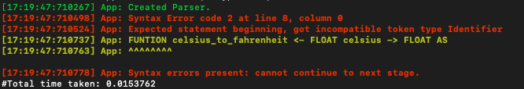
Evaluation
Rapid
Reliable
User friendly
Under 0.01 seconds
No known errors in transpilation
Requires knowledge of a command line interface

Slide 16
Conclusion
What have I learned?
What would I do differently if I was to do it again?

Slide 17
Questions?

